Slide 1


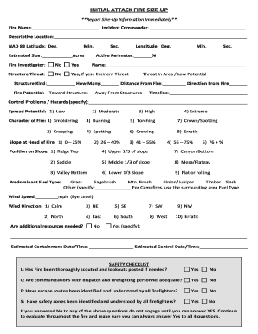
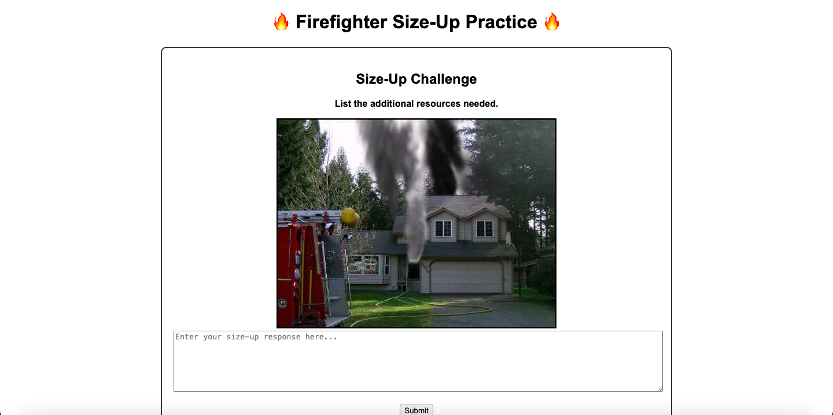
Fireground Readiness Online: Practicing Blue Card Size-Ups with Flask
By Ben Olson
This program allows firefighters to practice their Blue Card capabilities. Personnel using the program will be given a random photo of a building on fire and a random prompt to answer.

